Slide 1
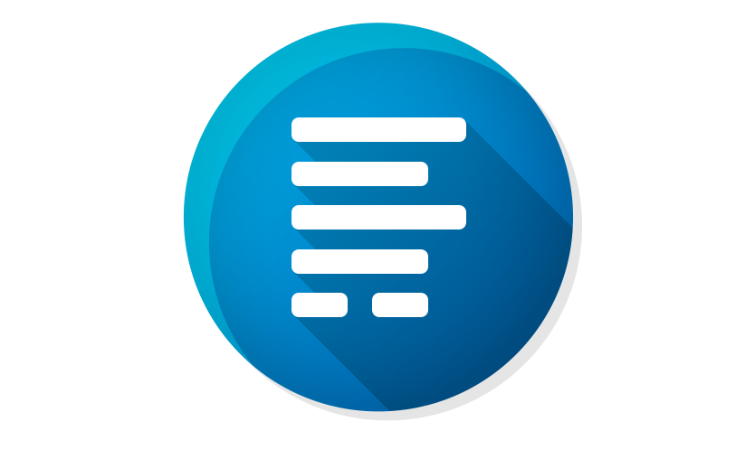
RSForm!Pro
How to communicate between forms and SQL Mapping

Slide 2
Warna - Multipurpose PowerPoint Template
Overview
Pre-filling Form Data
01
RSForm!Pro provides a specialized URL syntax that you can use when accessing a form to pre-fill field information.
User Registration Example
02
Practical approach using the RSForm!Pro Joomla! User Registration plugin.
Mappings
03
A powerful feature to expand various functionalities by adjusting database information without writing code.
SQL Example
04
Handling table insertion for special cases.

Slide 3
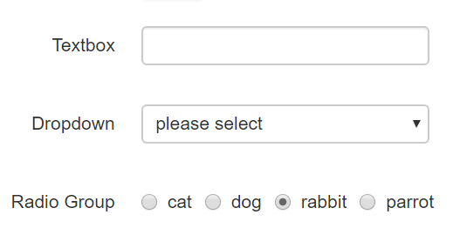
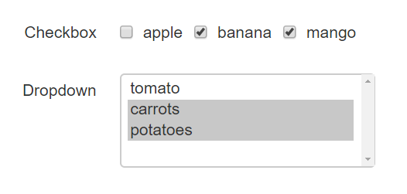
Warna - Multipurpose PowerPoint Template
Pre-filling Form Data via URL
Single values
Textbox, Dropdown, Radio
?form[field_name]=value
Multiple values
Checkboxes, Multiple Dropdown
?form[field_name][]=value1&form[field_name][]=value2
Special case (multiple fields)
Birthday Field
?form[field_name][d]=10&form[field_name][m]=11&form[field_name][y]=1985

Slide 4
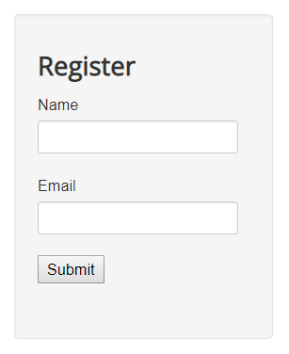
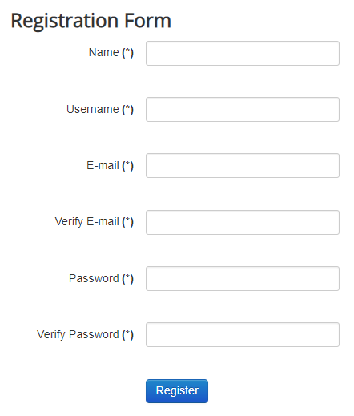
Warna - Multipurpose PowerPoint Template
Passing data
1
2
3
Module
Redirect + URL syntax
Main Form

Slide 5
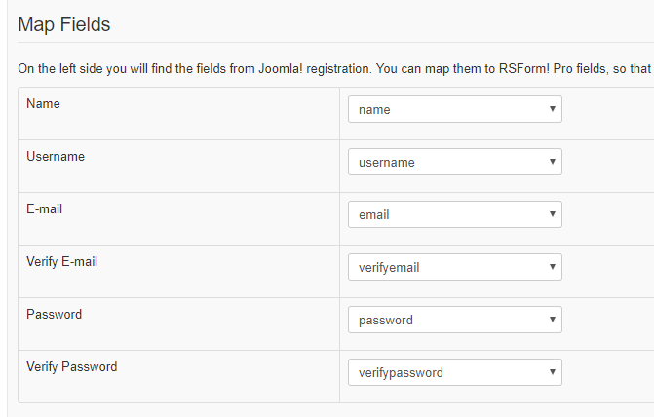
Warna - Multipurpose PowerPoint Template
RSForm!Pro - Joomla! User Registration plugin
Backend
Frontend

Slide 6
Warna - Multipurpose PowerPoint Template
Joomla! User Profile & User Custom Fields
User Profile (static)
Address 1
Address 2
City
Region
Country
Postal Zip Code
Phone
Website
Favorite Book
About Me
Date of Birth
User Custom Fields (dynamic)
Text
Textarea
Radio
Checkbox
URL
Integer
Color
Editor
List
& more…

Slide 7
Warna - Multipurpose PowerPoint Template
Mappings Tool
Mapping submission information to other database tables
1
2
Connect to Database
Mapping Type
3
4
Table Selection
Field Mapping

Slide 8
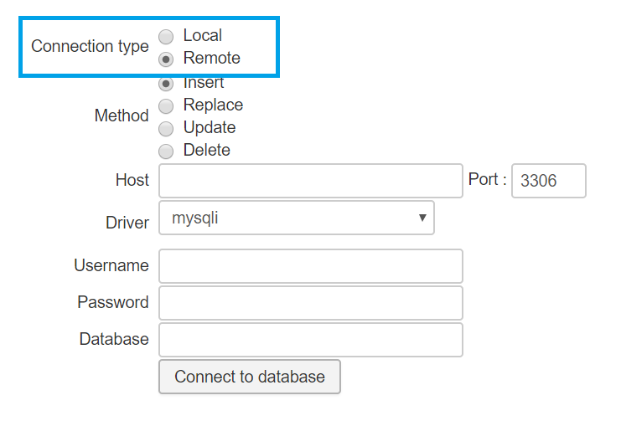
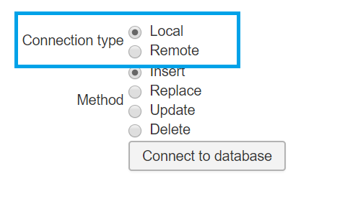
Warna - Multipurpose PowerPoint Template
Mappings Tool
1
Connect to Database

Slide 9
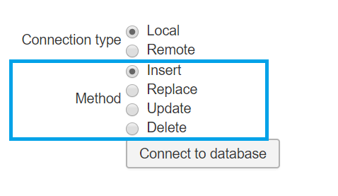
Warna - Multipurpose PowerPoint Template
Mappings Tool
2
Mapping Type
INSERT - add new record
UPDATE - edit existing record
DELETE - delete record
REPLACE - add or delete & add record

Slide 10
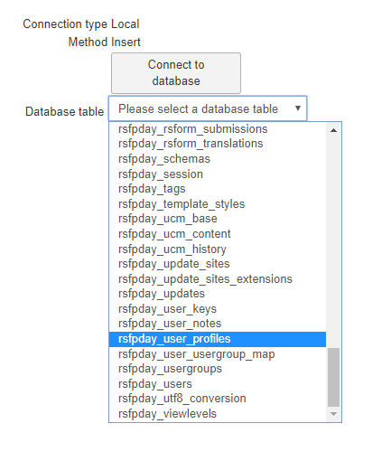
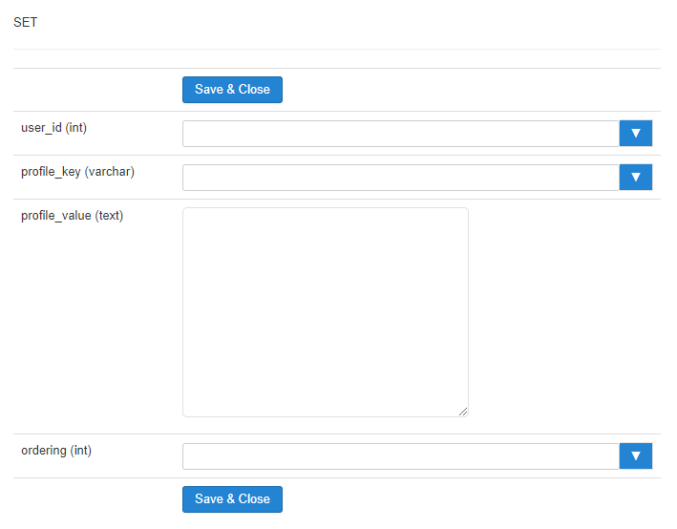
Warna - Multipurpose PowerPoint Template
Mappings Tool
3
4
Table Selection
Field Mapping

Slide 11
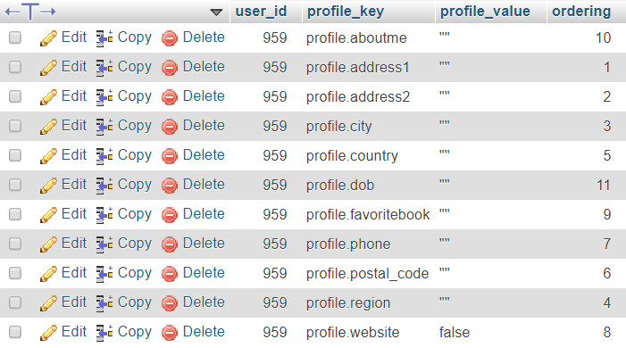
Warna - Multipurpose PowerPoint Template
Joomla! User Profile Database Structure
Table: #__user_profiles

Slide 12
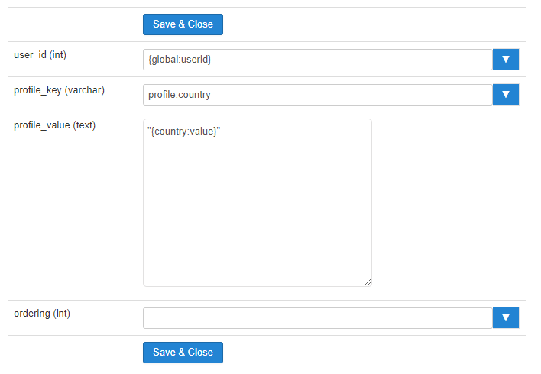
Warna - Multipurpose PowerPoint Template
Insert Mapping for User Profile
Field Mapping

Slide 13
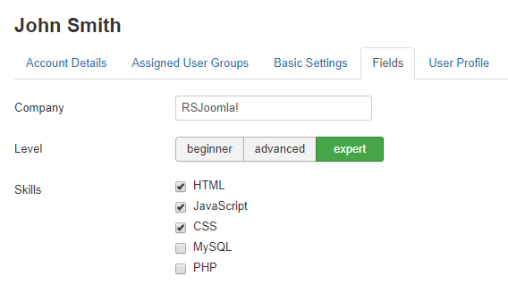
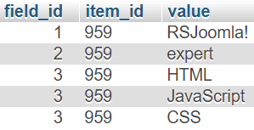
Warna - Multipurpose PowerPoint Template
Joomla! User Custom Fields Structure
User Custom Fields (backend > Users > Fields)
User
Data
Table: #__fields_values

Slide 14
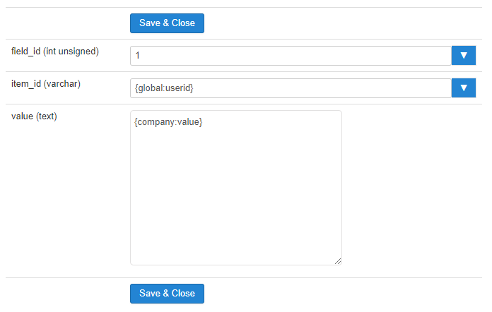
Warna - Multipurpose PowerPoint Template
Insert Mapping for User Custom Fields
Field Mapping

Slide 15
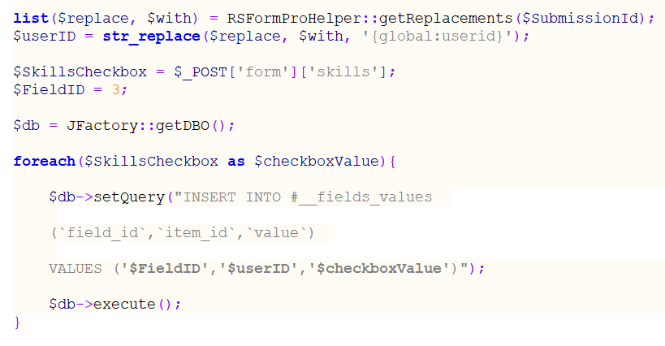
Warna - Multipurpose PowerPoint Template
SQL Example – inserting User Custom Fields data
Scripts Called After Form Has Been Processed

Slide 16
Warna - Multipurpose PowerPoint Template
Summary
Pre-filling Form Data
01
RSForm!Pro provides a specialized URL syntax that you can use when accessing a form to pre-fill field information.
User Registration Example
02
Practical approach using the RSForm!Pro Joomla! User Registration plugin.
Mappings
03
A powerful feature to expand various functionalities by adjusting database information without writing code.
SQL Example
04
Handling table insertion for special cases.
www.rsjoomla.com

